Slide 1
Day 7: Game Components
Notes:
Hello and welcome to day 4 of camp! This is Makayla and today we’ll be talking a little bit about the different components of video games. This presentation is to help get you and your team thinking about your final project, which is designing your own game!

Slide 2
Contents
Types of Characters
Types of Story Narratives
Rules
Notes:
Here’s the outline of this presentation, first we’re going to be talking about different types of characters you can have in your game. Next we’re going to talk about different types of stories you can utilize for your game. Then we’re going to talk about some rules that the players or characters may have to follow when playing your game. Lastly, we’re going to quickly talk about different technologies you can use for your game.

Slide 3
Types of Characters
The Fighter
The Big Bad
The Sage
The Sidekick
Notes:
Let’s jump into the different types of characters. In this section, we’ll talk about 4 main character types with some examples of each. There may be other types of characters that you want to add to your game that aren’t on this list, and that’s fine. The four types we’ll talk about today are the fighter, the big bad, the sage, and the sidekick.

Slide 4
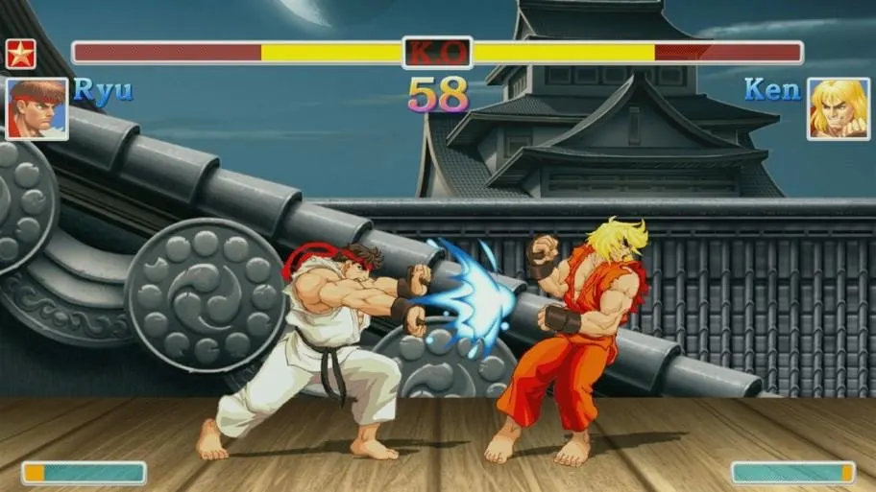
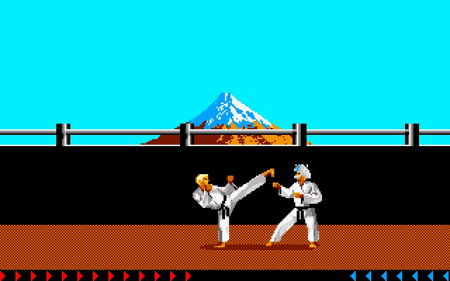
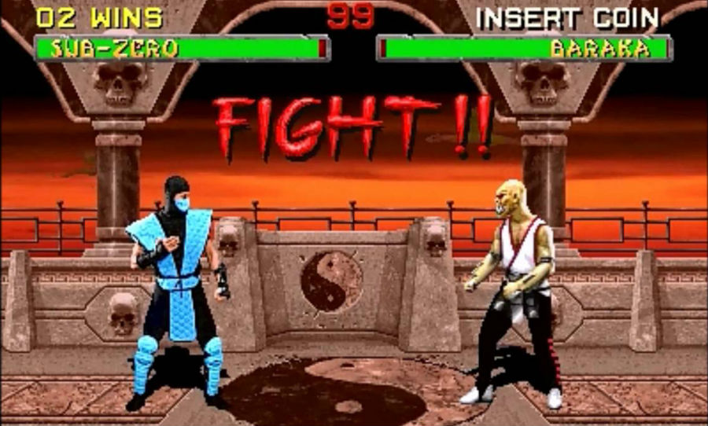
The Fighter
The Fighter is a hero who fights the enemy with their fists, feet, or weapons.
Examples below include Street Fighter, Karateka, and Mortal Kombat.
Another fighting game example would be Super Smash Bros.
Notes:
First up is the fighter character type. This is the hero who fights the enemy with their fists, feet, or weapons. Some examples of video games that use this type of character include Street Fighter, Mortal Kombat, and Super Smash Brothers.

Slide 5
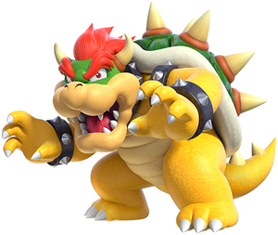
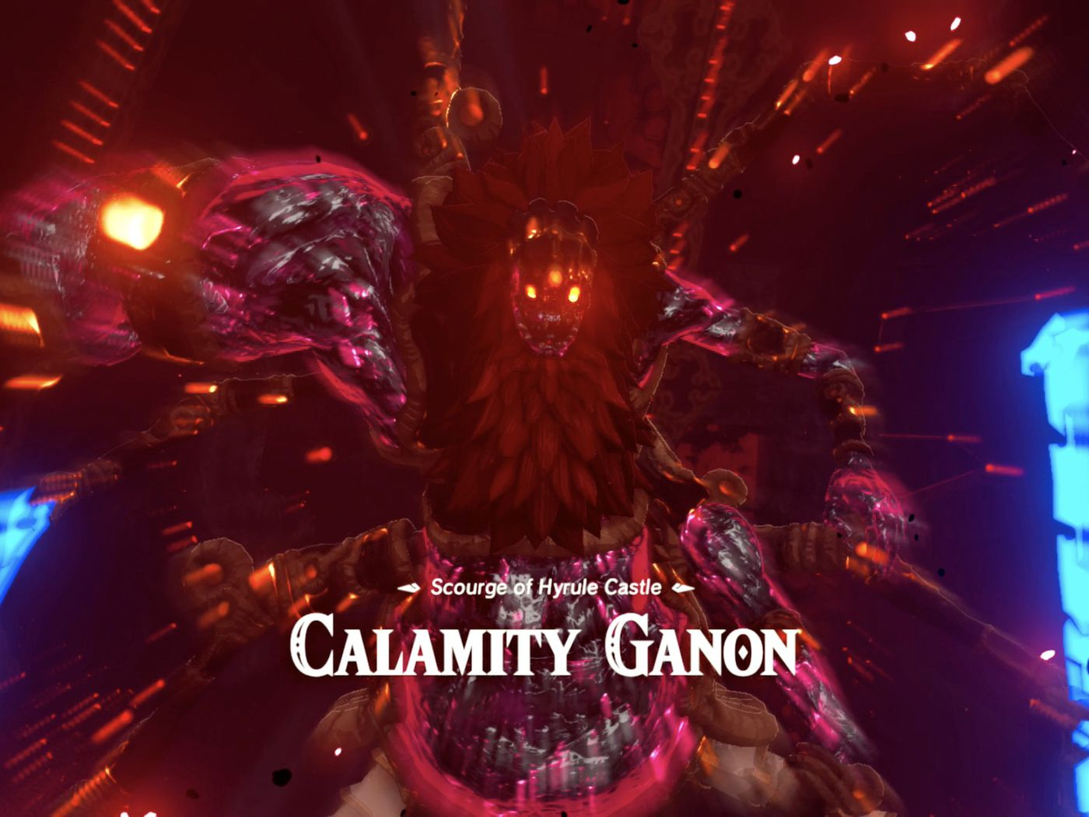
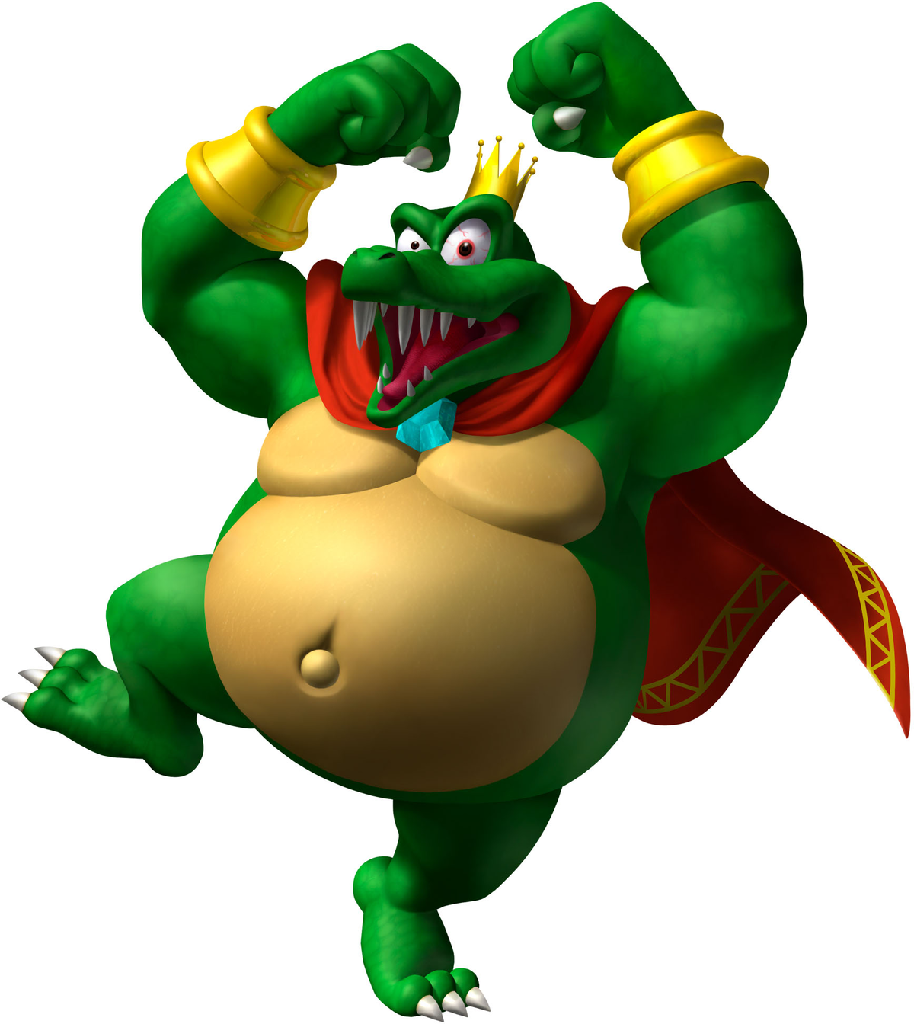
The Big Bad
A dastardly villain who appears to be stronger than the hero but has a hidden weakness.
Examples below include Gannon from The Legend of Zelda, King K Rool from Donkey Kong, and Bowser from Super Mario.
Notes:
Next is the big bad character type. The big bad is a villain who appears to be stronger than the hero but has a hidden weakness. Some examples include Calamity Gannon from the Legend of Zelda, King K Rool from Donkey Kong, and Bowser from Super Mario.

Slide 6
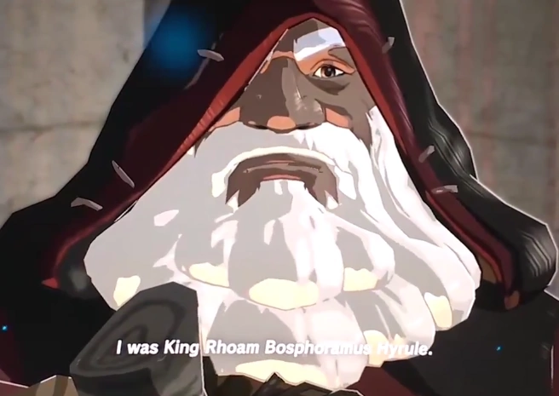
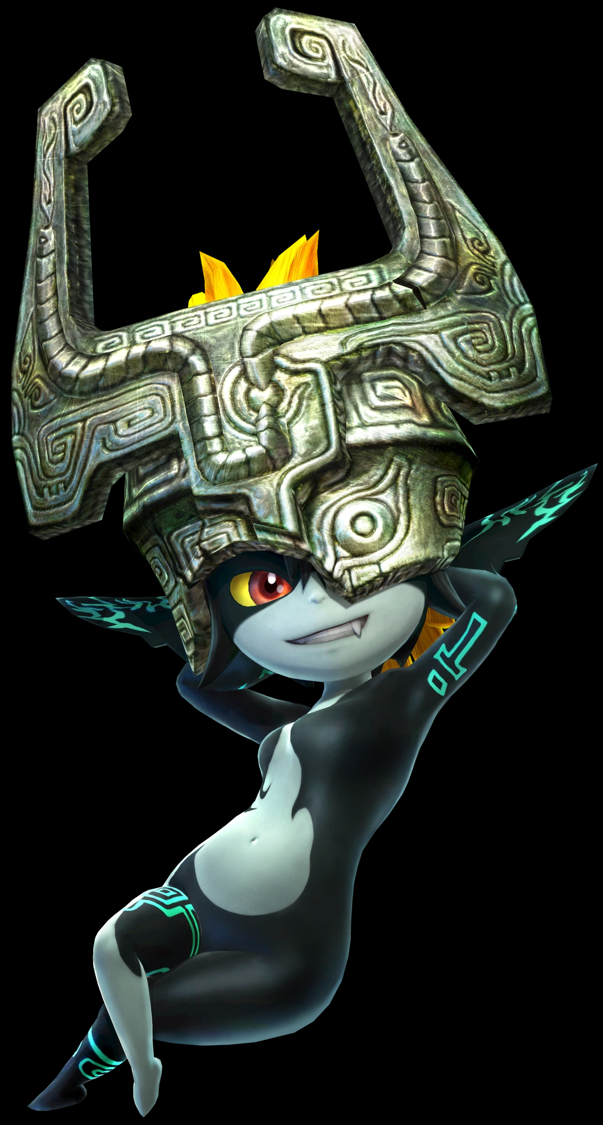
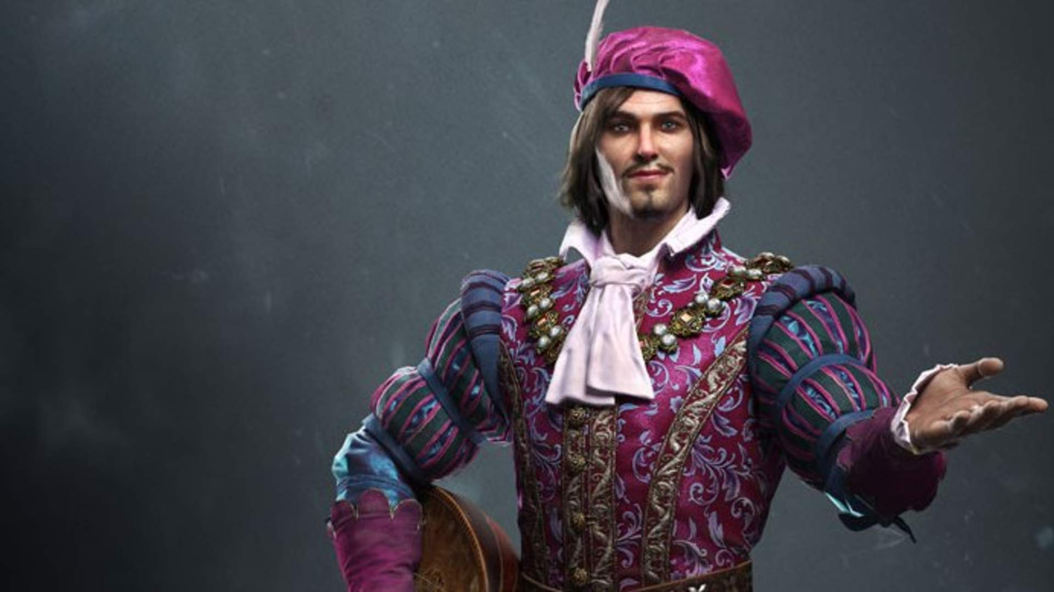
The Sage
The Sage is a mystic, odd character allied with the hero who provides helpful hints at crucial times during the game.
Examples include King Roam Bosphoramus Hyrule and Midna from Legend of Zelda and Dandelion/Jaskier from The Witcher 3.
Notes:
Now for the sage. The sage is an odd character who is allied with the hero who provides helpful hints at crucial times during the game. Some examples are King Rhoam Bosphoramus Hyrule who helps Link in the beginning of The Legend of Zelda: Breath of the Wild, Midna also helps Link in Twilight Princess, and then Dandelion helps Geralt in the Witcher 3.

Slide 7



The Sidekick
The Sidekick is a companion to the hero who provides comic relief or aids the hero in solving their quest.
Examples include Luigi from Mario Brothers, Yoshi in Mario World, and Tails from Sonic.
Notes:
Lastly we’ll talk about the sidekick, they are a companion to the hero who provides comic relief and aids the hero in solving their quest. Some examples are Luigi, Yoshi, and Tails.

Slide 8
10-Minute Group Breakouts
Take a moment to think about the different character types you just learned about.
Is there a specific character type you would want to see in your game?
Character Types
The Fighter
The Big Bad
The Sage
The Sidekick
In your Team Folder, there is a Journal Folder with a doc for Day 7. As a group, answer the questions under “Character Discussion.”
Notes:
Now we’re going to do a thinking exercise. Think about the different character types and examples that were just presented. Is there a specific character type you would want to see in your final project? Write down your thoughts to share with your group. Go ahead and pause the video now.

Slide 9
Types of Story Narrative
Overcoming the Monster
Rags to Riches
The Quest
Voyage and Return
Rebirth
The Neverending Story
Notes:
Next we’re going to talk about the different types of story narrative.

Slide 10
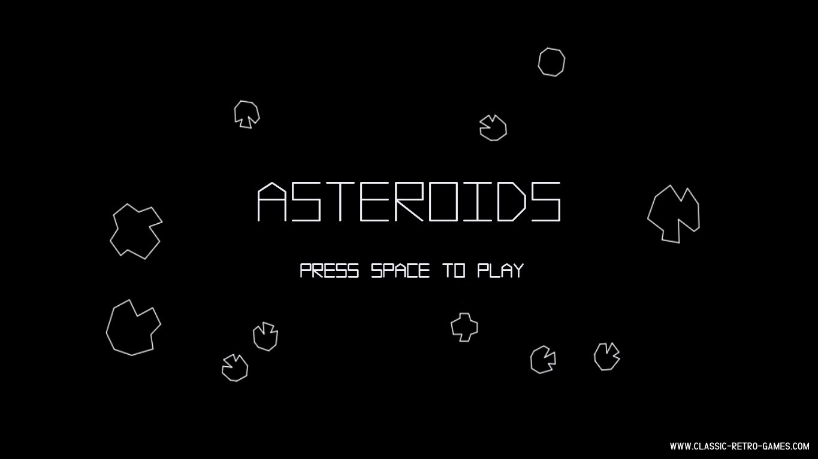
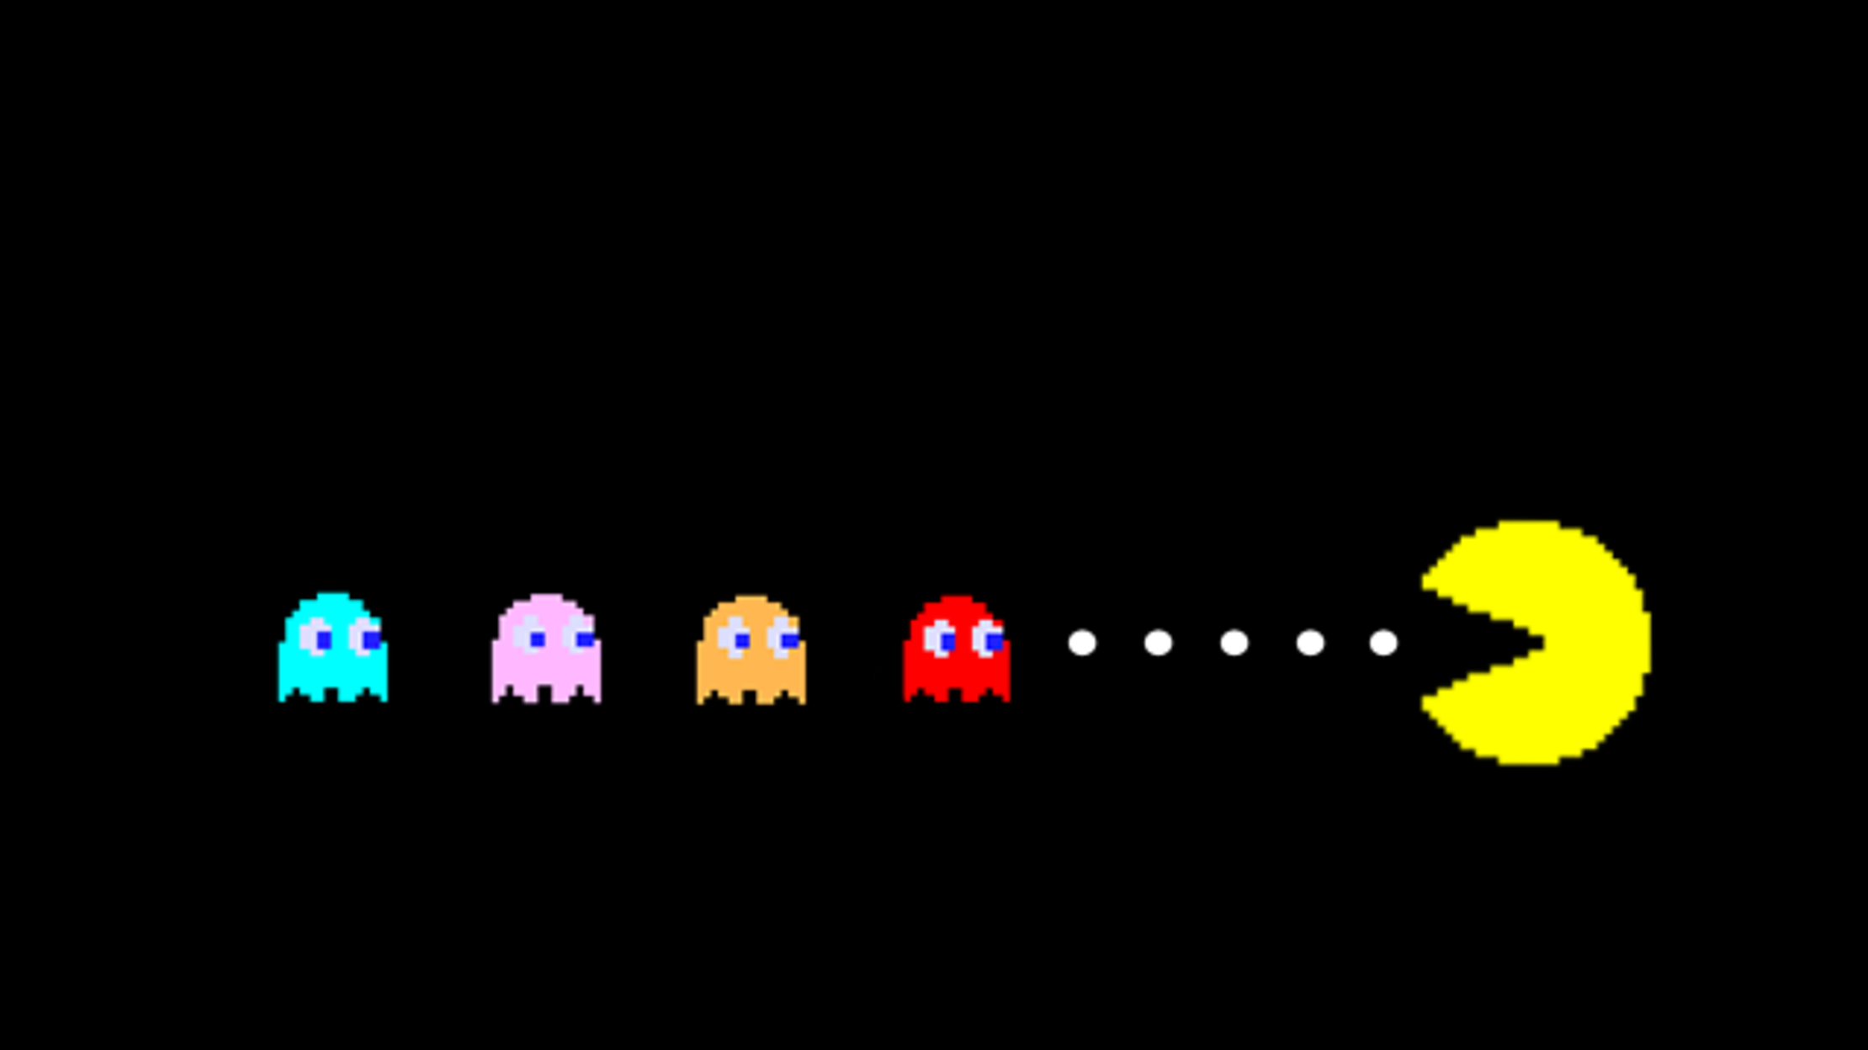
Overcoming the Monster
The hero must fight and slay the monster that threatens their community.
Examples include King Kong, PacMan, Mario Bros., Space Invaders, Asteroids, and Galaga.
Notes:
First up is overcoming the monster where the hero must fight and slay the monster that threatens their community. Some examples include King Kong (which is a movie), Mario brothers, space invaders, asteroids, galaga, and pacman. In Asteroids, the hero is a space ship who has to shoot asteroids to make it safely through the game.

Slide 11
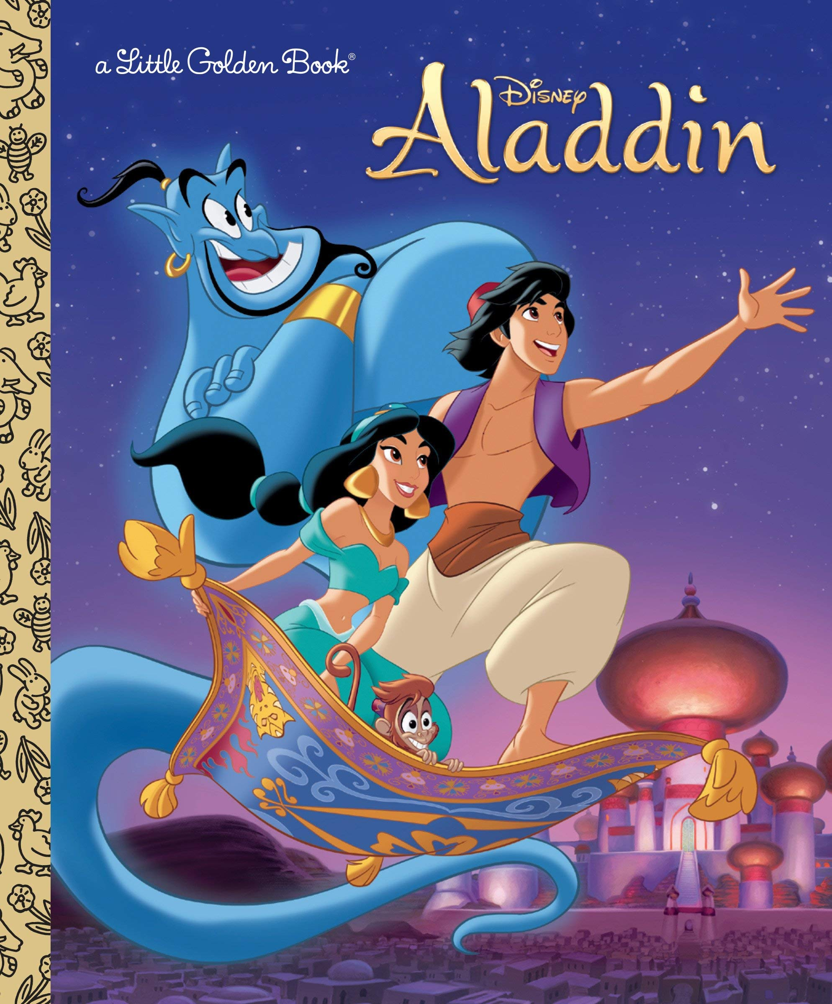

Rags to Riches
An insignificant person is dismissed by others around them. Something happens to elevate them, revealing that person to be exceptional.
Examples include the Ugly Duckling, Aladdin, and Superman.
Notes:
The next type of story is the rags to riches story. For this one, an insignificant person is dismissed by others around them, but something happens to elevate them, revealing that person to be exceptional. Some story examples are the Ugly Duckling, Aladdin, and Superman.

Slide 12
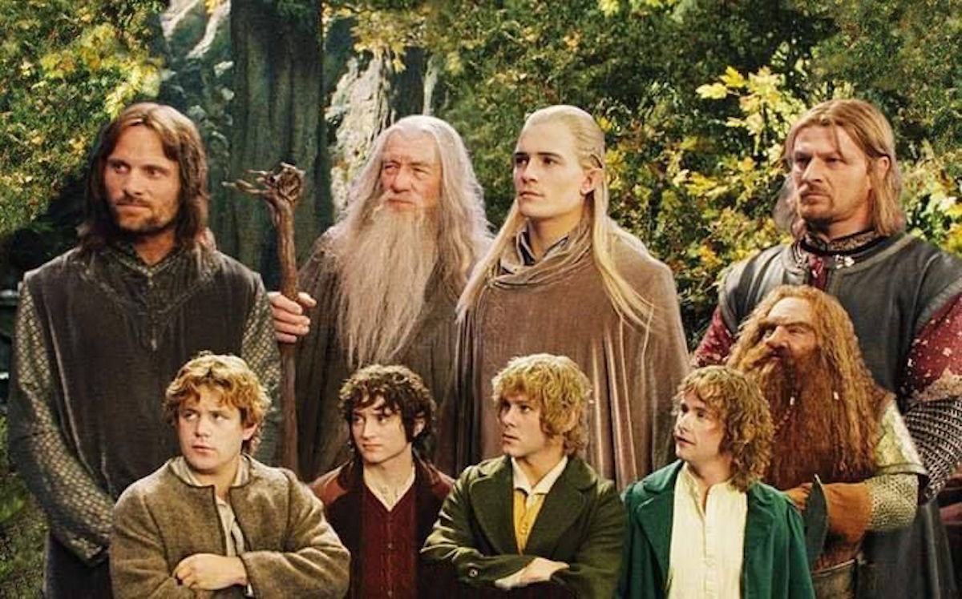


The Quest
The hero must set out on a long hazardous journey to battle obstacles until they are triumphant.
Examples include The Lord of the Rings, Harry Potter, Wizard of Oz.
Notes:
Next is the quest storyline. The hero must set out on a long hazardous journey to battle obstacles until they are triumphant. Some movie examples are the lord of the rings, harry potter, and the wizard of oz.

Slide 13
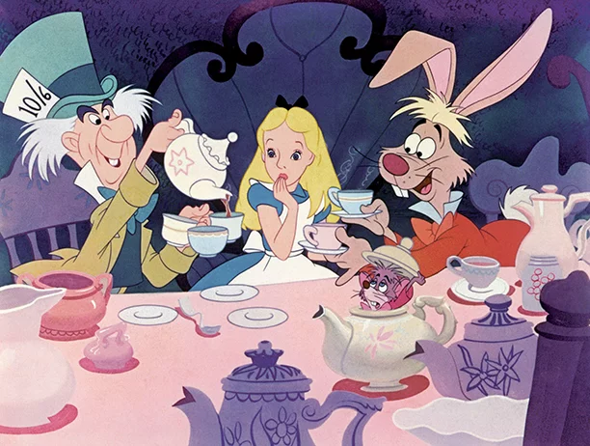


Voyage and Return
The hero travels out of their normal world into the unknown and overwhelming, before escaping back to the safety of their home.
Examples include Alice in Wonderland, Finding Nemo, Wreck-it Ralph
Notes:
The fourth type of story is voyage and return. In this story, the hero travels out of their normal world into the unknown and overwhelming, before escaping back to the safety of their home. Movie examples include alice in wonderland, Finding Nemo, and Wreck-it Ralph.

Slide 14
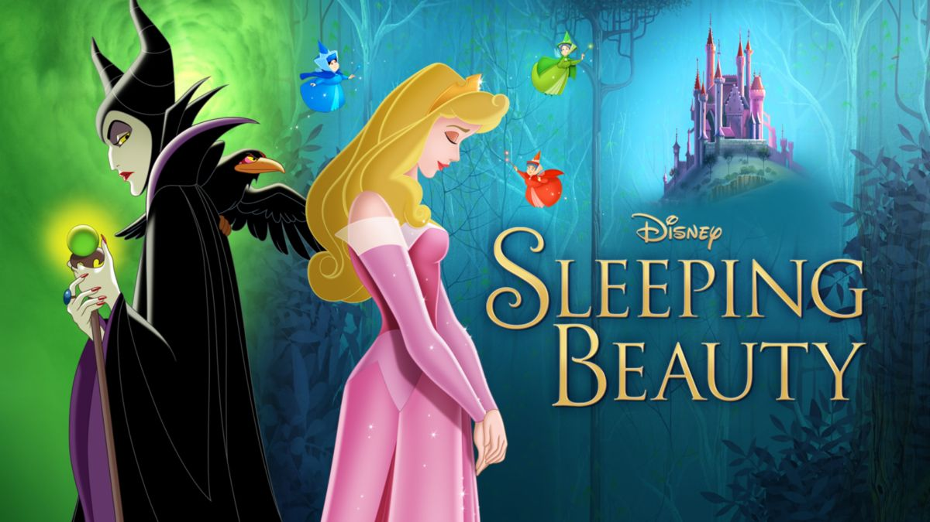
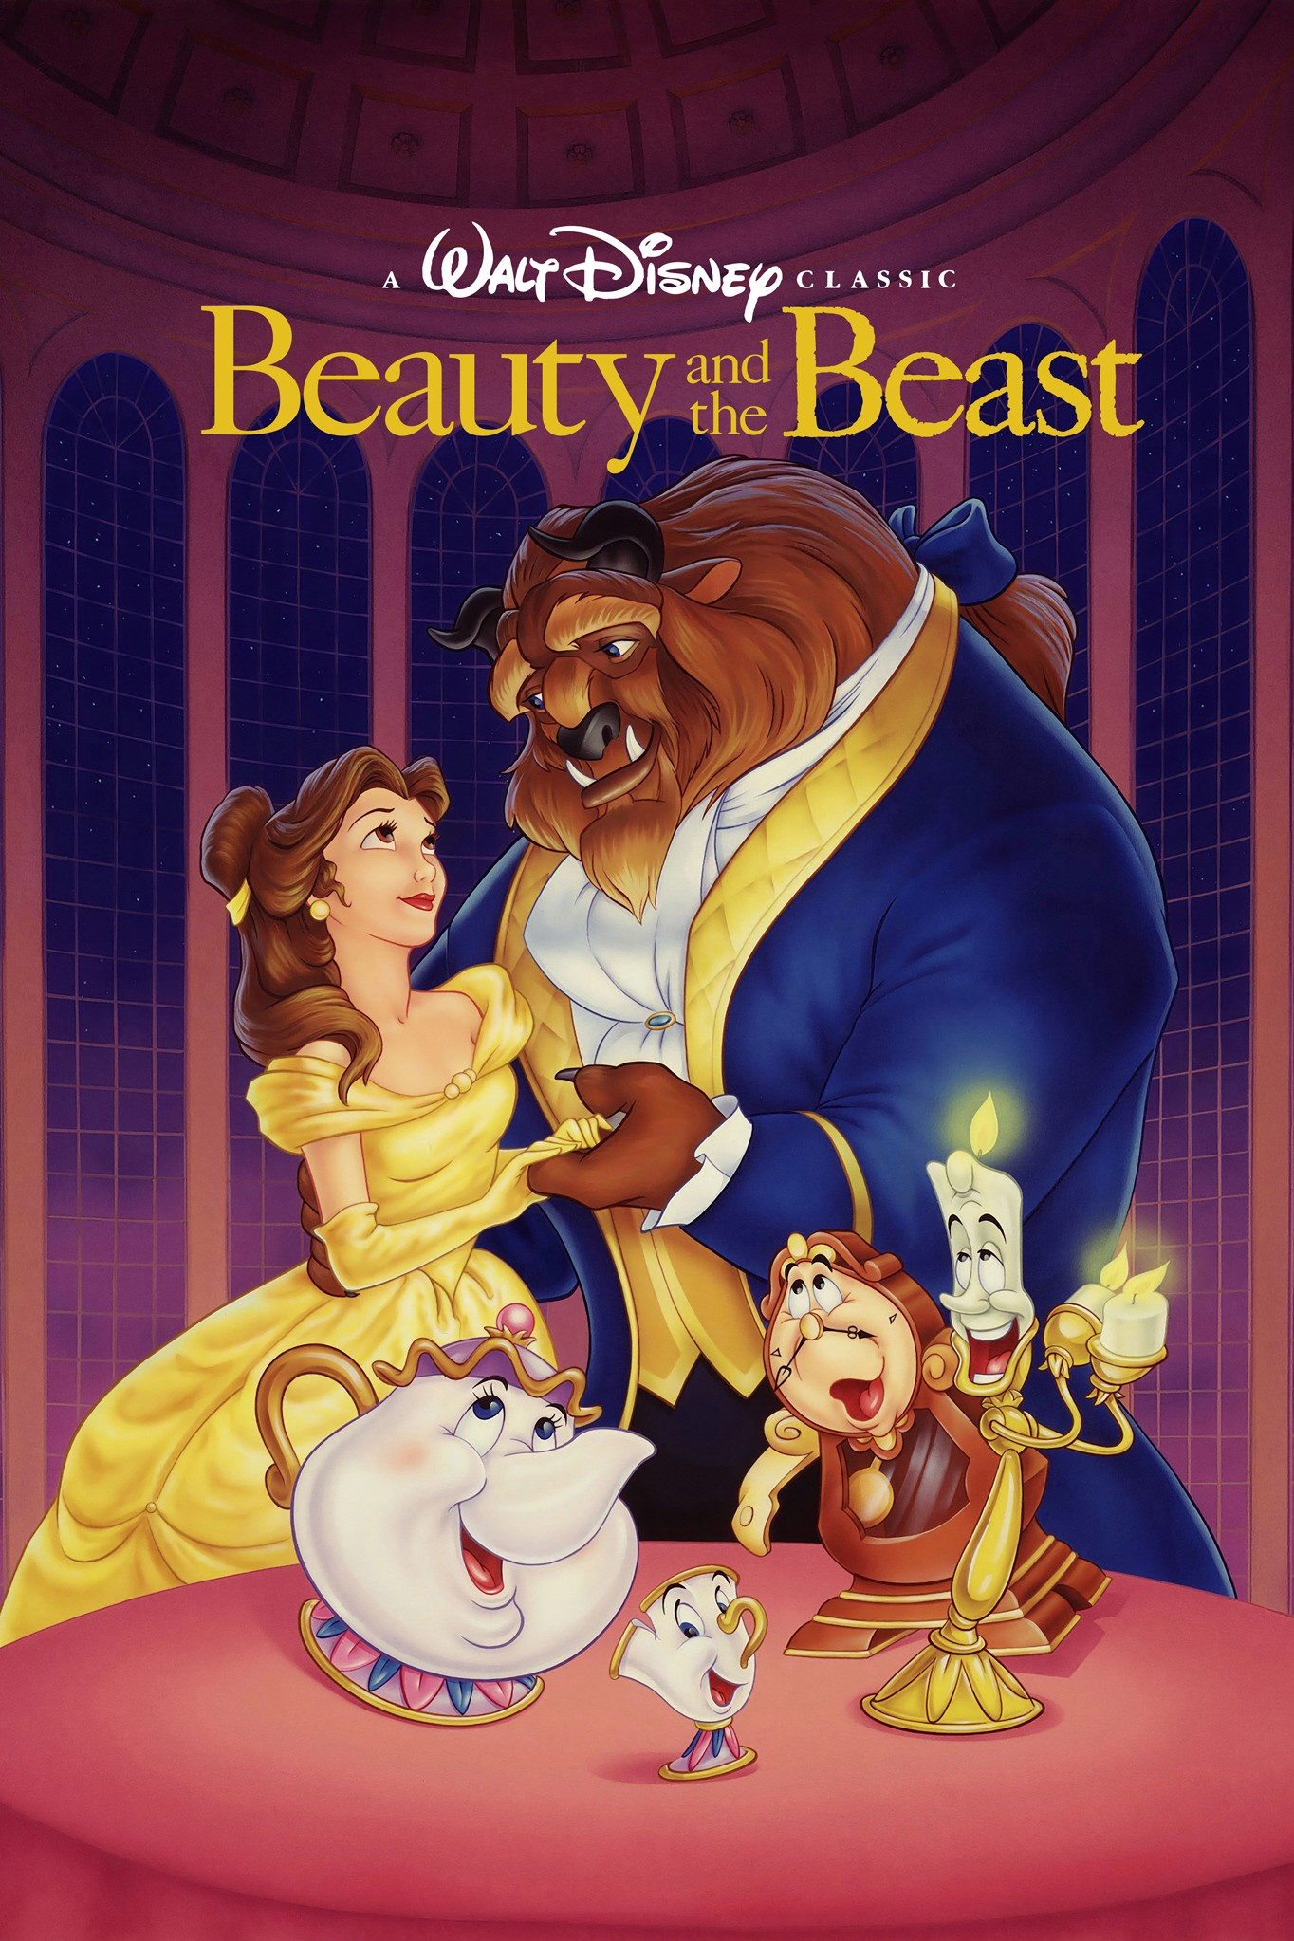
Rebirth
The hero falls under a dark spell (e.g. sleep, sickness, enchantment) before breaking free and being redeemed.
Examples include Sleeping Beauty and Beauty and the Beast.
Notes:
Next is the rebirth storyline where the hero falls under a dark spell before breaking free and being redeemed. Some examples are sleeping beauty and beauty and the beast.

Slide 15
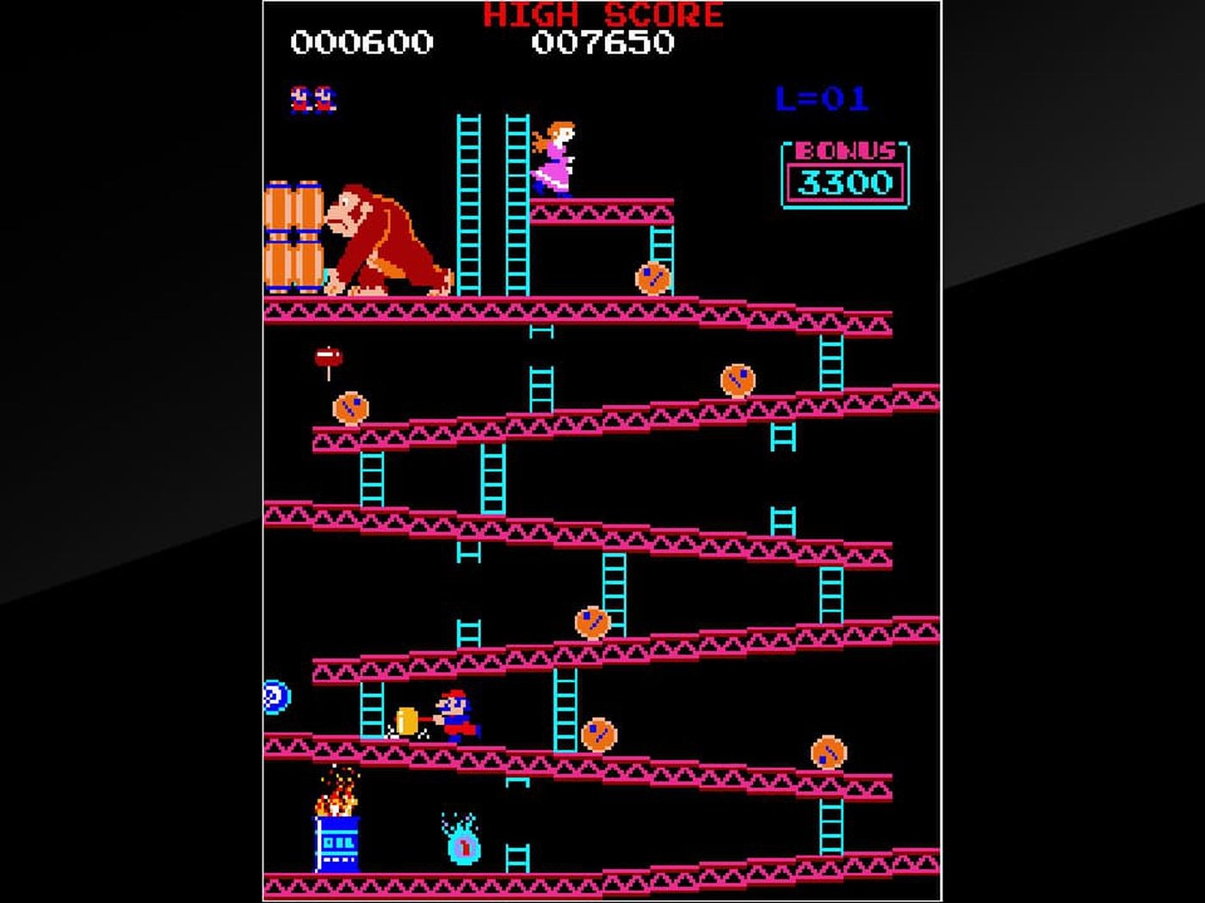
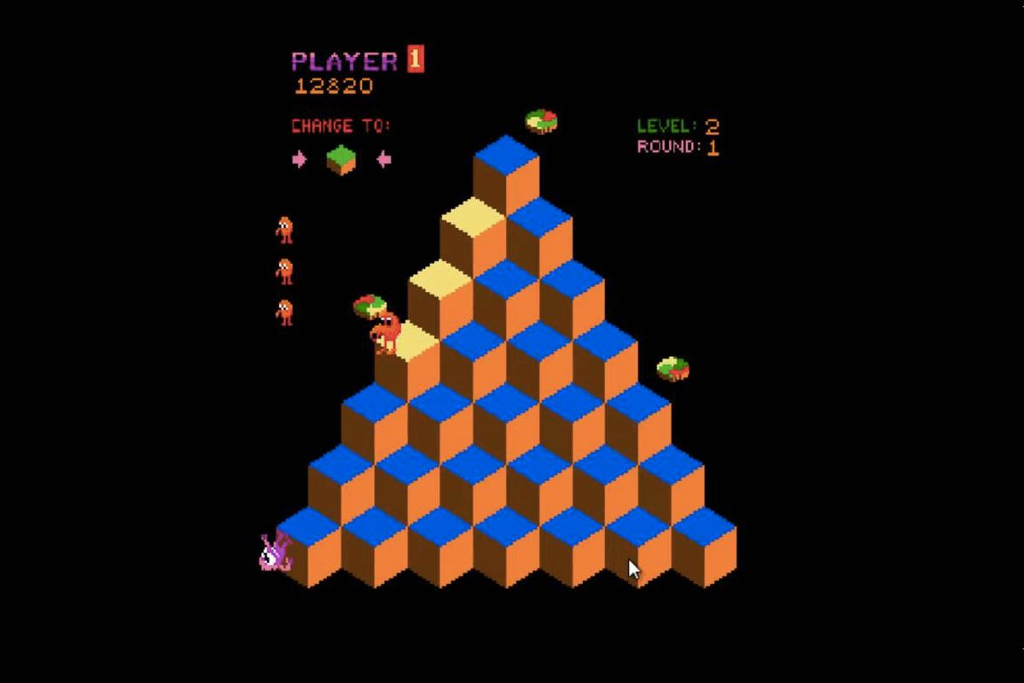
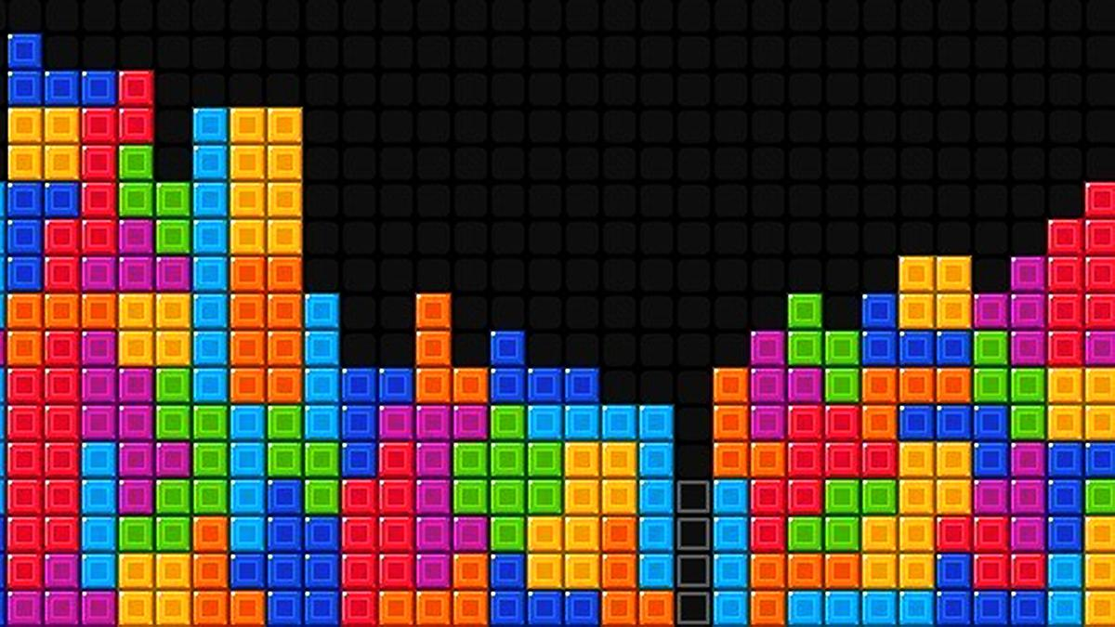
The Neverending Story
A repetitive story with infinite challenges that get more and more difficult to beat.
Does not need to have a storyline.
Examples include Donkey Kong, Q*bert, Tetris.
Notes:
Lastly, we’ll talk about stories that might not have a storyline, but are repetitive, known as the neverending story. This is a repetitive story with infinite challenges that get more and more difficult to beat. Some examples are Donkey Kong, Q*bert, and Tetris.

Slide 16
10-Minute Group Breakouts
Take a moment to think about the different story types you just learned about.
Is there a specific story you would want to see in your game?
Story Types
Overcoming the Monster
Rags to Riches
The Quest
Voyage and Return
Rebirth
The Neverending Story
In your Team Folder, there is a Journal Folder with a doc for Day 7. As a group, answer the questions under “Narrative Discussion.”
Notes:
Now we’re going to do a thinking exercise. Think about the different story types and examples that were just presented. Is there a specific type of storyyou would want to see in your final project? Write down your thoughts to share with your group. Go ahead and pause the video now.

Slide 17
Rules
Rules define how the characters can move through the game world and describes the actions they can take and their effects.
Navigation
Information
Inventory
Obstacles
Fighting
Dying
Winning
Notes:
Next we’re going to talk about the rules of video games. There are different types of rules such as navigation, information, inventory, obstacles, fighting, dying, and winning.

Slide 18

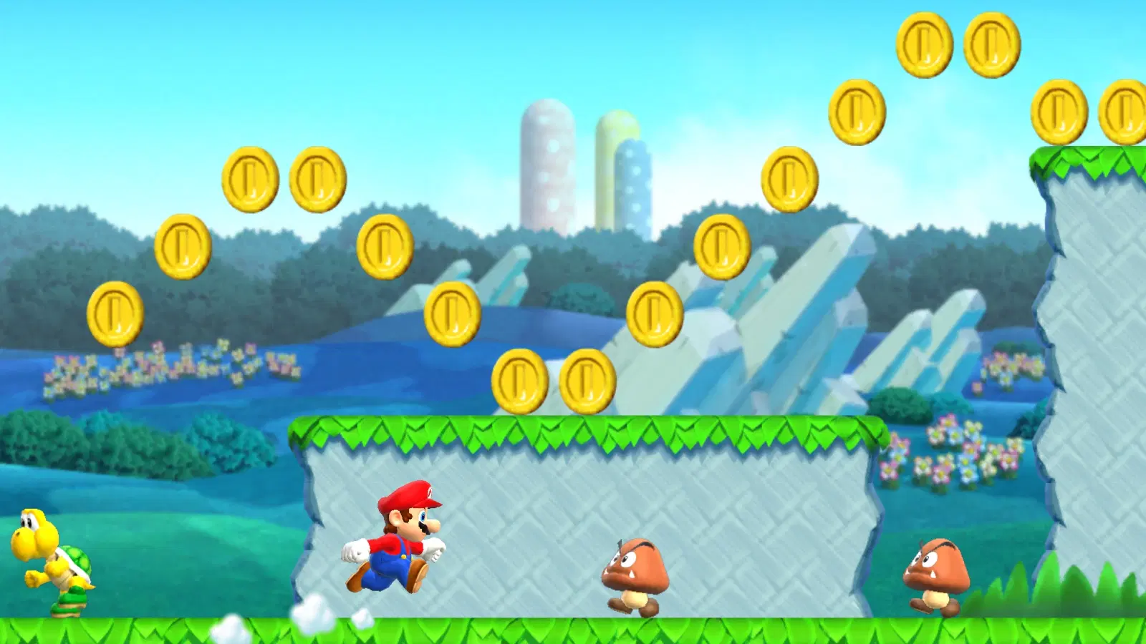
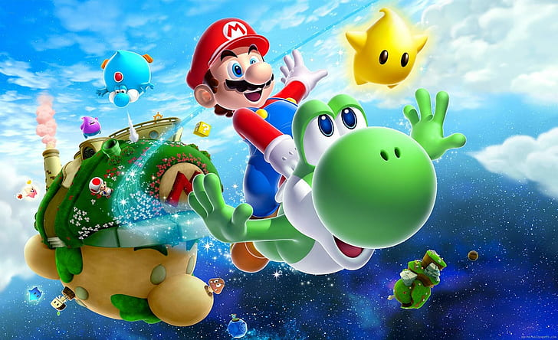
Navigation
How the hero gets around the world
Walking, running, swimming, flying
Notes:
First up is navigation, which is how the hero gets around the world. Will they fly, run, walk, or swim?

Slide 19
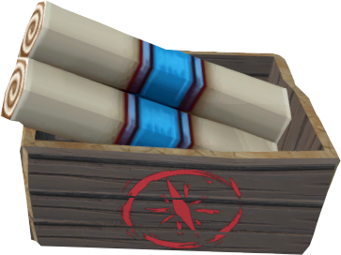
Information
There are many ways for a hero to get information
Reading a scroll
Listening to a character
Notes:
You may also want to include ways for the main character to gather information. Some might include finding and reading a scroll or talking with another character.

Slide 20
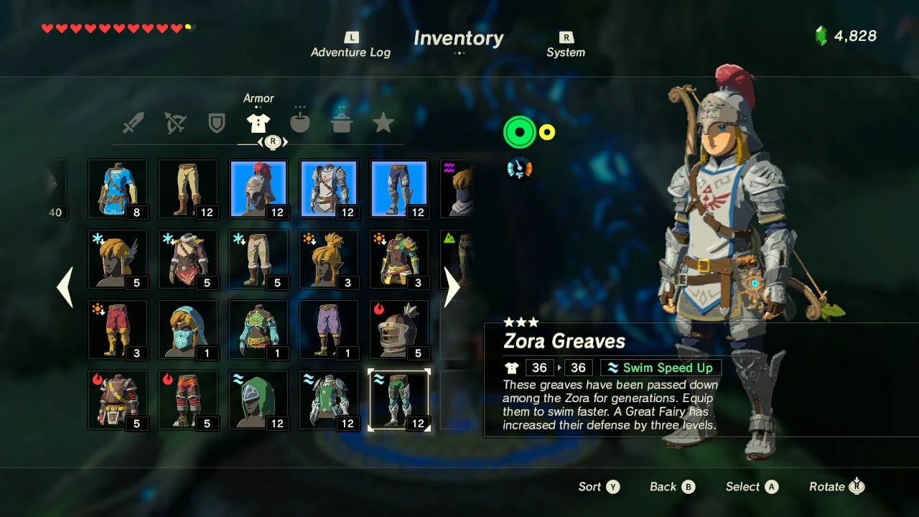
Inventory
Will the character have to pick up objects? Where will they be stored? How will they be stored?
Picking up an item
Choosing to use an item
Dropping an item
Losing an item
Notes:
You may also want to incorporate an inventory for characters to store items. There are different mechanics with an inventory that include using items, placing items, dropping items, and sometimes even losing an item.

Slide 21
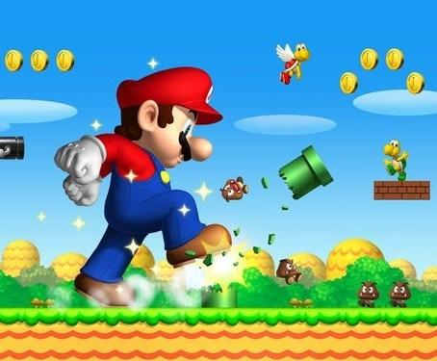
Obstacles
Will there be enemies?
Jumping
Running
Fighting
Will there be environment obstacles?
Notes:
Next there are rules for obstacles – this slide is about figuring out what the obstacle is and how the character will get past the obstacle. Will there be enemies in your game? How will the character defeat or get around them? Will the jump over or on them, run away from them, or fight them? Will there be obstacles in the environment such as locked doors?

Slide 22
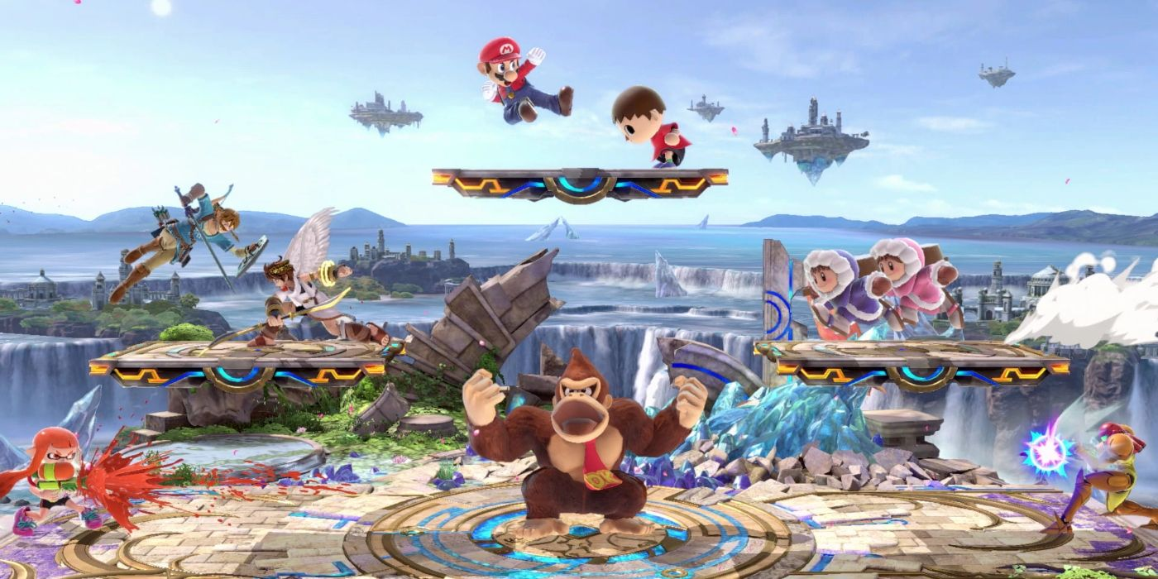
Fighting
Will the characters need to fight? If so, how?
Punching
Jumping
Kicking
Running through
Weapon
Round-off back handspring
Notes:
Next up is fighting. If the characters in your game need to fight, how will they do so? Will they punch, jump, kick, run, use a weapon, or do a round-off back handspring?

Slide 23
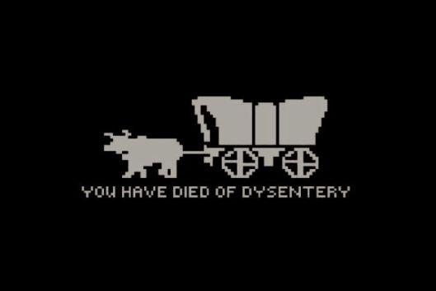
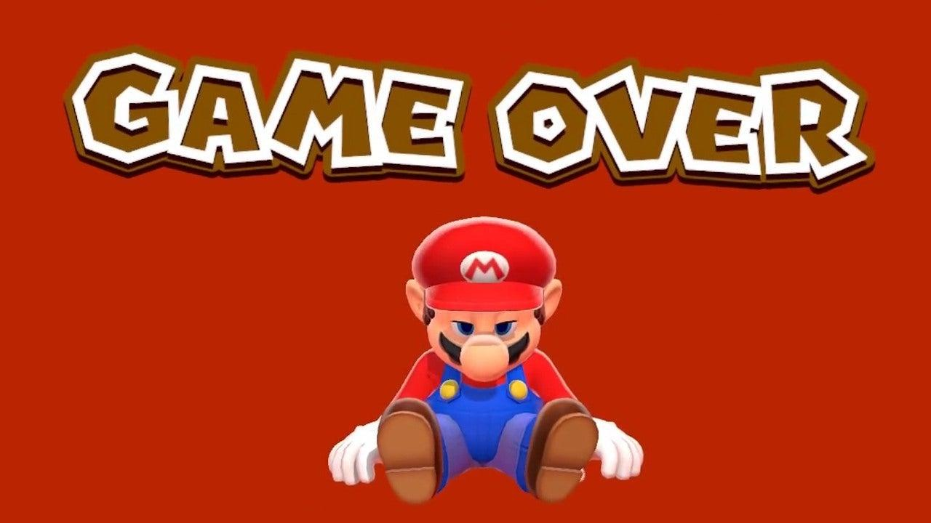
Dying
Will the characters be able to die? If so, how?
Getting run over?
Getting hit?
Jumping into a pit?
Running into an enemy?
Notes:
Next up is the dying rules. If the characters are able to die, how will they do so? Will they get run over, hit an object, fall into a pit, or run into an enemy?

Slide 24

Winning
How will your character win?
Eating all of the food?
Defeating all enemies?
Solving all puzzles?
Notes:
Winning – what is the win condition of your game? Will the character win by eating all of the food? Defeating all enemies? Or Solving all puzzles?

Slide 25
10-Minute Group Breakouts
Take a moment to think about the different rule types you just learned about.
Is there a specific rule set you would want to see in your game?
In your Team Folder, there is a Journal Folder with a doc for Day 7. As a group, answer the questions under “Rules Discussion.”
Notes:
Now we’re going to do another thinking exercise. We just went over a lot of different rules that you may want in your games. Think about the different types and examples that were just presented. Is there a specific rule set you would want to see in your final project? Write down your thoughts to share with your group. Go ahead and pause the video now.

Slide 26
Technology
Button Mapping
Secret Game Modes
Notes:
Lastly, we’ll talk about the technology used for your game, which includes button mapping and secret game modes.

Slide 27
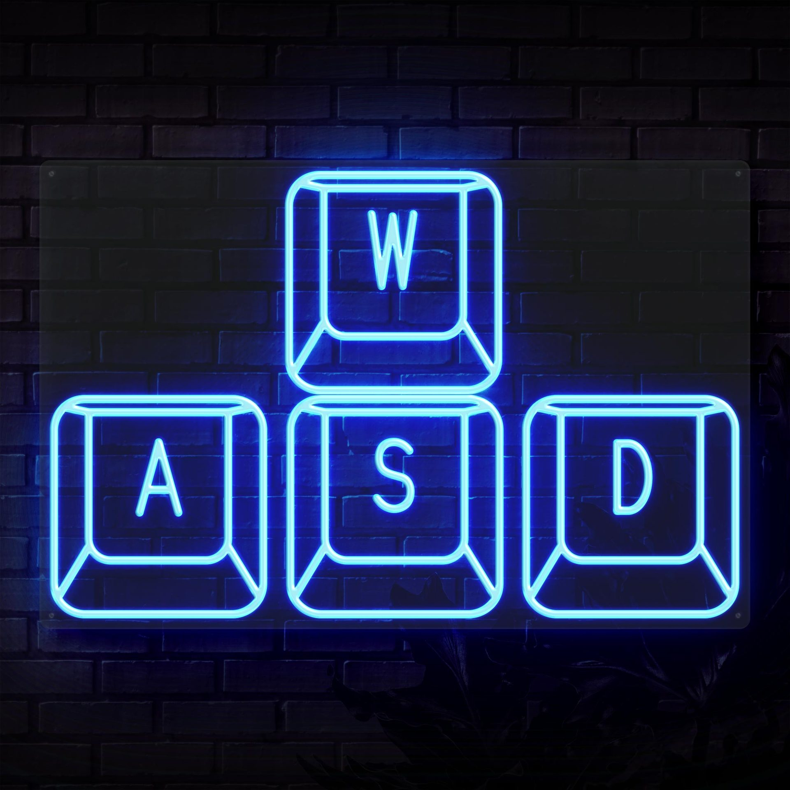
Button Mapping
Mapping buttons to player actions.
Arrow Keys
WASD
Space bar
Notes:
Button mapping is just mapping the control buttons to the player actions. Usually for computer games these include the arrow keys, the keys WASD, and the space bar.

Slide 28
Secret Game Modes
Secret Game Modes are like easter eggs for the users to find.
Example: Pressing A and B together makes the character invisible to monsters.
Another example is to type “do a barrel roll” into a google search bar.
Notes:
Finally, we’re going to talk about secret game modes, or easter eggs. These are hidden from the player and are usually stumbled upon by chance. And example within a video game would be to press both A and B to make the character invisible to monsters. And another example is to type do a barrel roll into a google search bar and watch what happens.

Slide 29
Final Project Brainstorm
Think about the components of this presentation while brainstorming with your group about what your final project will look like.
Remember to talk about the notes you took during this presentation!
Notes:
Now we’ll move into a group activity where you all will talk with your final project groups about your game and discuss what components you would want to see in it!

